Slide 1

Content Trends Analysis for Strategic Recommendations for Netflix
Prasanth M
ID - INTERNSHIP_17546440516895be537820f

Slide 2

PROBLEM STATEMENT
Netflix, one of the world’s leading streaming platforms, hosts a vast library of Movies and TV Shows spanning multiple genres, countries, and release years. With growing competition from platforms like Amazon Prime, Disney+, and regional OTT providers, it has become critical for Netflix to strategically analyze its content catalog. The goal is to uncover how Netflix’s content distribution — across Movies vs. TV Shows, genres, and country contributions — has evolved over time. This analysis will help identify trends, audience preferences, and strategic insights that can guide Netflix in content acquisition, production planning, and regional expansion.

Slide 3
Project Description
This project aims to perform an exploratory data analysis (EDA) on Netflix’s content dataset to discover trends and insights that can influence data-driven business strategies.
Objectives:
Analyze how Netflix’s content library has evolved over the years in terms of volume and category (Movies vs TV Shows).
Identify top-performing genres and countries contributing to Netflix’s catalog.
Examine audience-oriented aspects such as ratings distribution, duration trends, and content diversity.
Generate data visualizations to present insights clearly for decision-making and reporting.
Provide actionable recommendations for Netflix’s future strategic decisions, such as focusing on certain genres, countries, or formats.

Slide 4

WHO ARE THE END USERS?
End User | Role / Purpose
Netflix Content Strategy Team | Identify which genres or countries to invest in for future productions.
Data Analysts / Business Analysts | Use data insights to monitor trends and forecast audience engagement.
Marketing Teams | Tailor promotional campaigns based on genre and audience preferences.
Production & Acquisition Teams | Decide where to allocate budgets for original or licensed content.
Executives / Decision-Makers | Gain a data-backed understanding of global performance and content gaps.

Slide 5

Technology Used
Technology / Tool | Purpose
Python | Primary programming language for data manipulation and analysis.
Pandas | Data cleaning, transformation, and aggregation.
Matplotlib & Seaborn | Visualization of trends, patterns, and comparisons.
NumPy | Numerical computations and handling missing data.
Jupyter Notebook / VS Code | Development environment for analysis and visualization.
LLMs | LLMs like ChatGPT are used for coding and analysis purpose.

Slide 6
Sample Code
# 1. Content Distribution: Movies vs TV Shows
content_type_count = df['Category'].value_counts()
plt.figure(figsize=(6,6))
colors = sns.color_palette("pastel")
plt.pie(content_type_count, labels=content_type_count.index, autopct='%1.1f%%', colors=colors)
plt.title('Distribution of Movies vs TV Shows on Netflix')
plt.show()
# 2. Content Growth Over the Years
yearly_trend = df.groupby(['Year', 'Category']).size().reset_index(name='Count')
plt.figure(figsize=(12,6))
sns.lineplot(data=yearly_trend, x='Year', y='Count', hue='Category', marker='o')
plt.title('Netflix Content Growth Over the Years')
plt.xlabel('Year')
plt.ylabel('Number of Titles Added')
plt.grid(True)
plt.show()

Slide 7
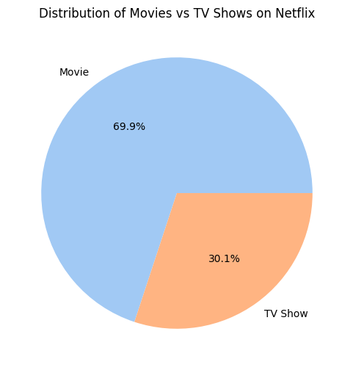
RESULTS1

Slide 8
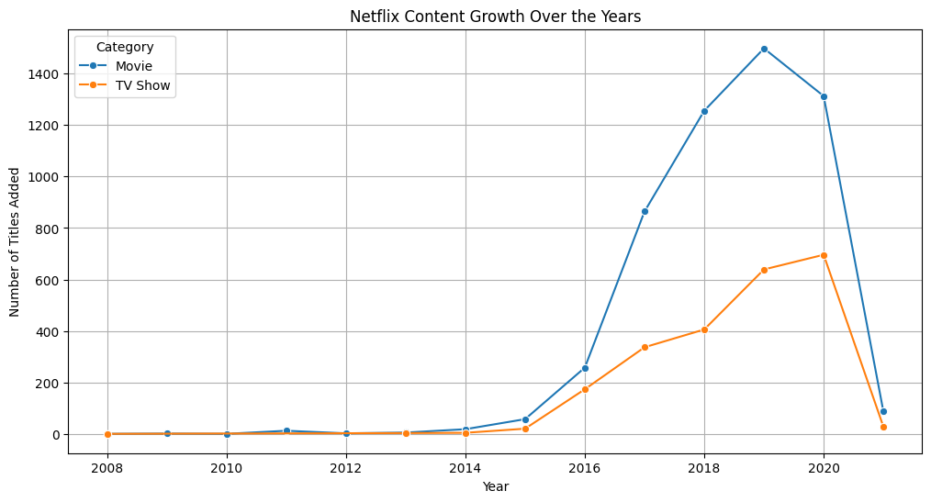
RESULTS2

Slide 9
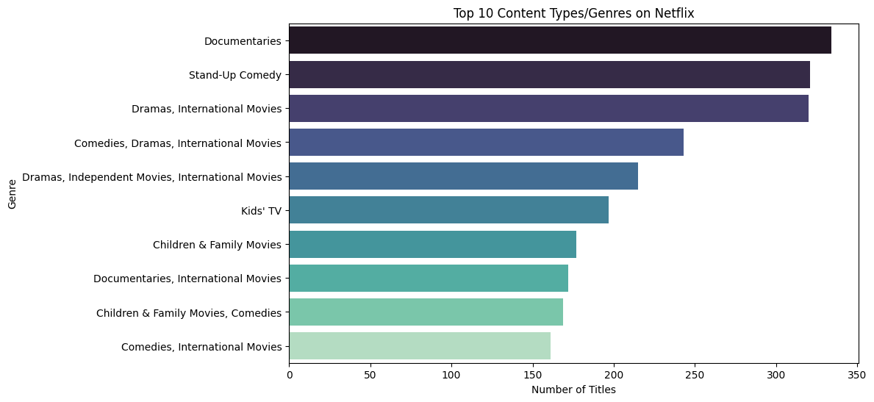
RESULTS3

Slide 10
GitHub repository
GitHub Repository Link - https://github.com/1905Pras/VOIS_AICTE_Oct2025_MajorProject_Prasanth-M.git

Slide 11
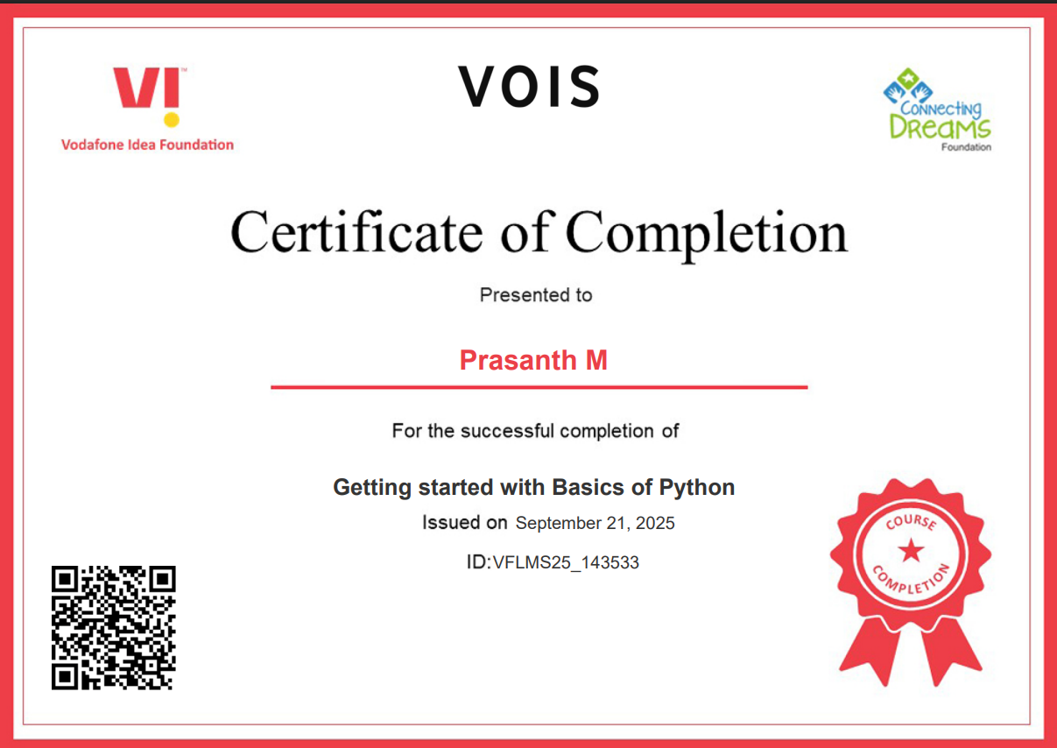
Getting started with Basics of Python Certificate

Slide 12
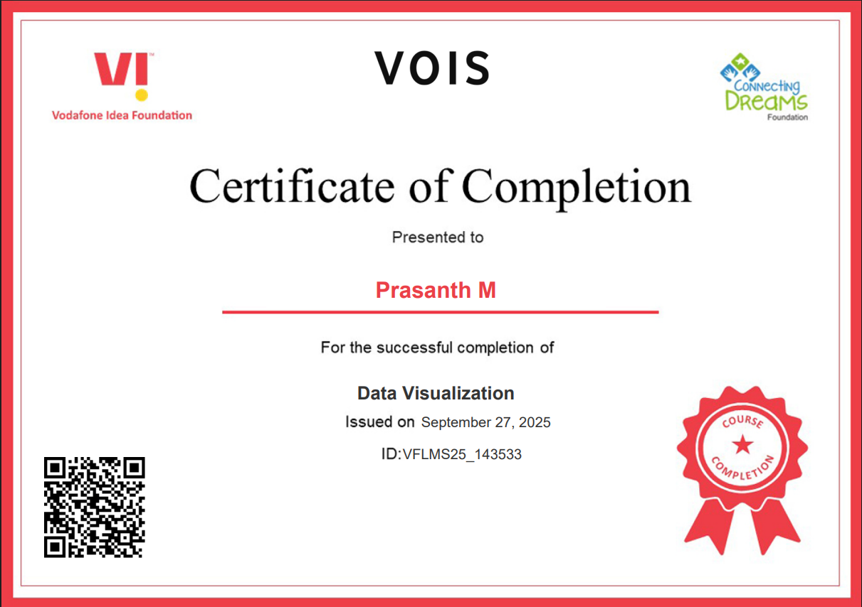
Data Visualization Certificate

Slide 13
Thank you
.
.

